Slide 1


Slide 2
Pickaway-Ross Career and Technology Center
Jason Vesey – Director
jason.vesey@pickawayross.com
Kim Graves – Job Placement Coordinator - kim.graves@pickawayross.com
Allen Koker – Job Placement Coordinator – allen.koker@pickawayross.com
Rhonda Lawless - Business Services Coordinator – rhonda.lawless@pickawayross.com
Susan Schwalbauch – ACAD Specialist – susan.schwalbauch@pickawyross.com

Slide 3
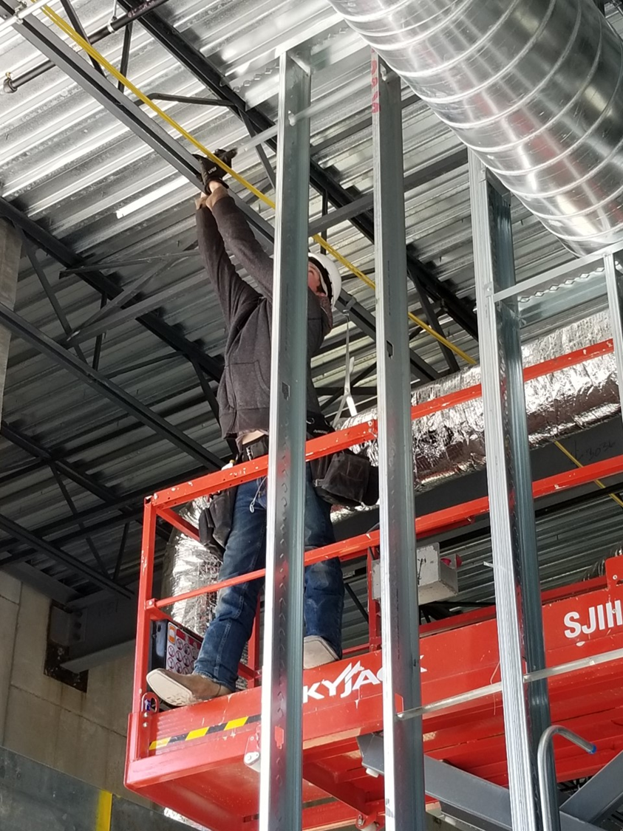
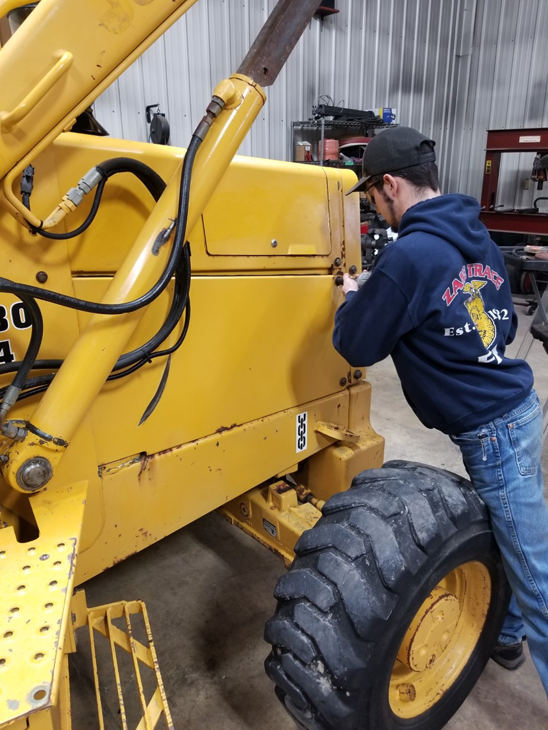
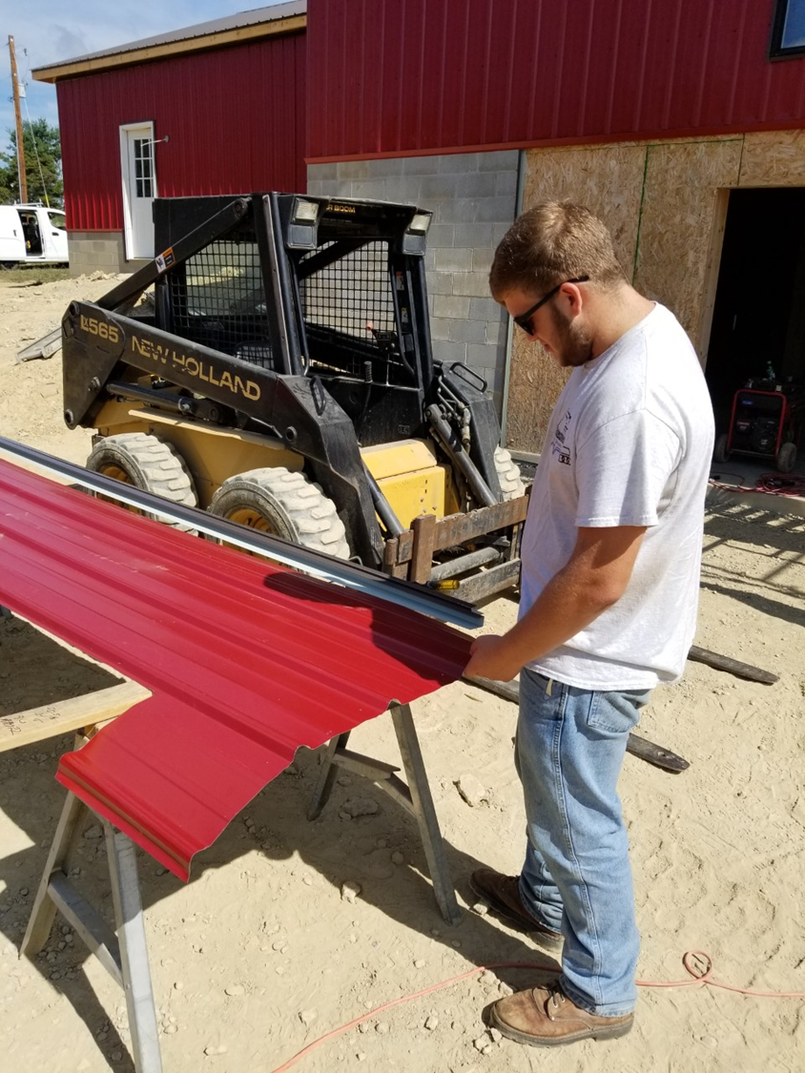
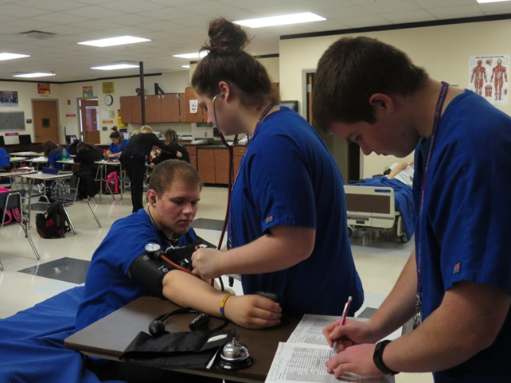
EMPLOYMENT TRENDS

Slide 4
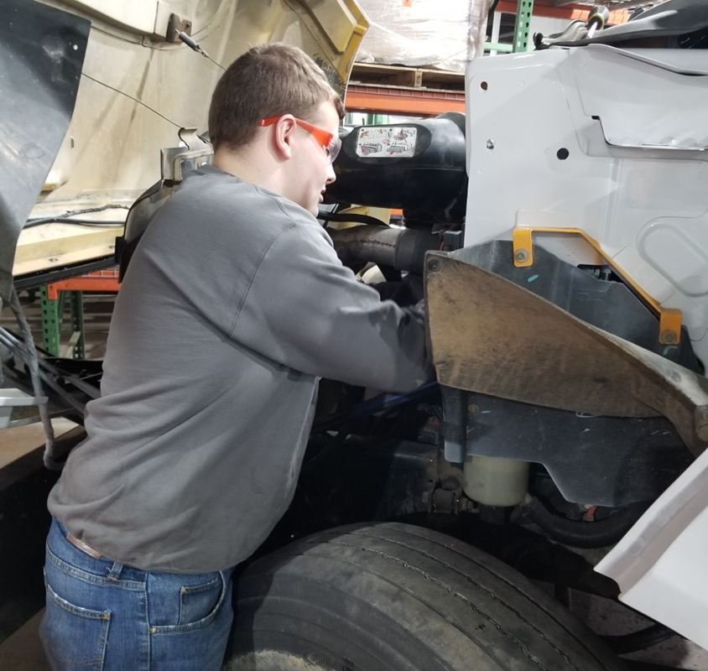
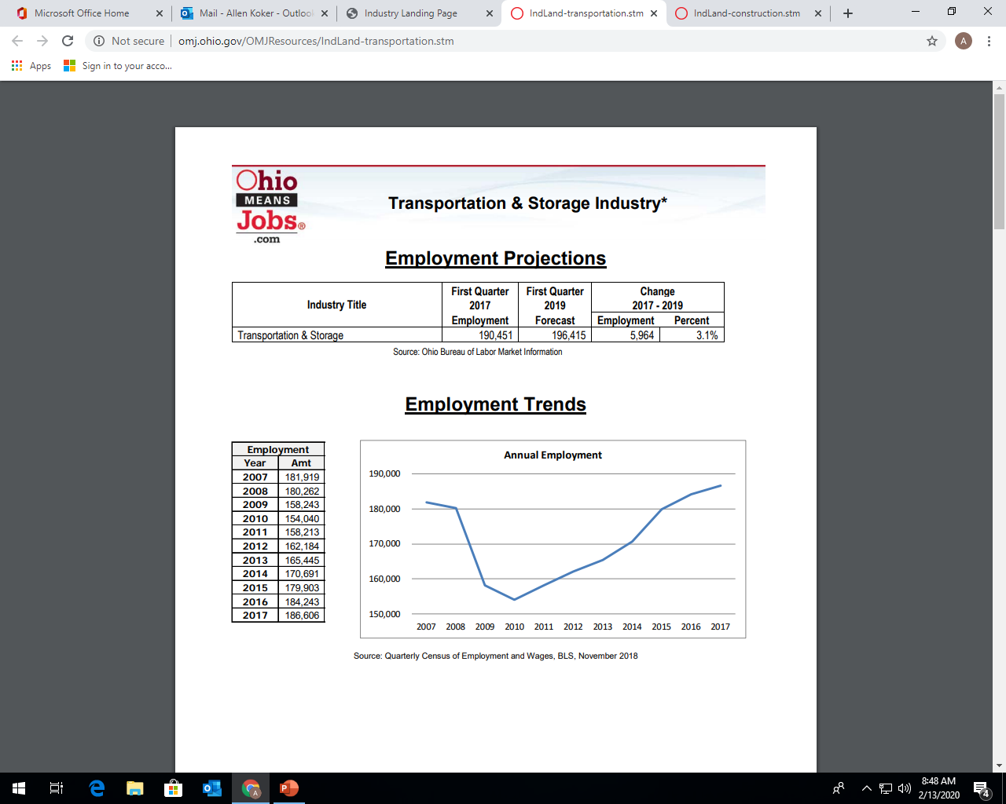

Slide 5
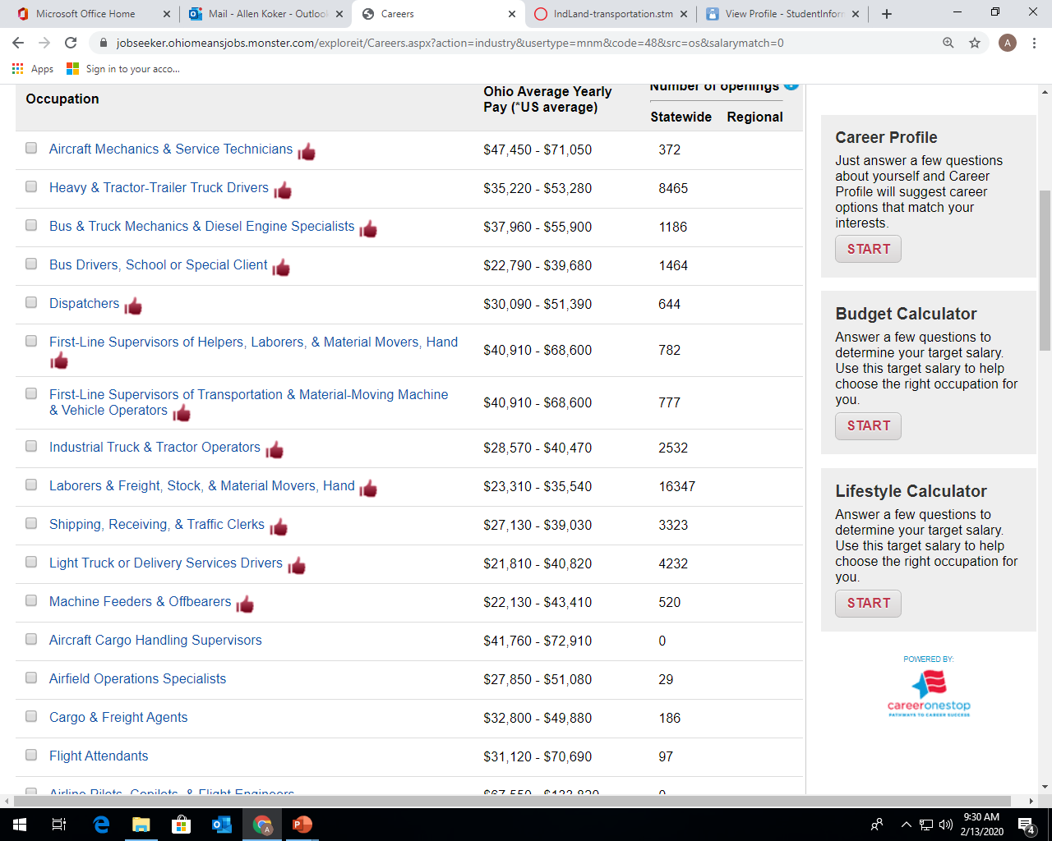

Slide 6

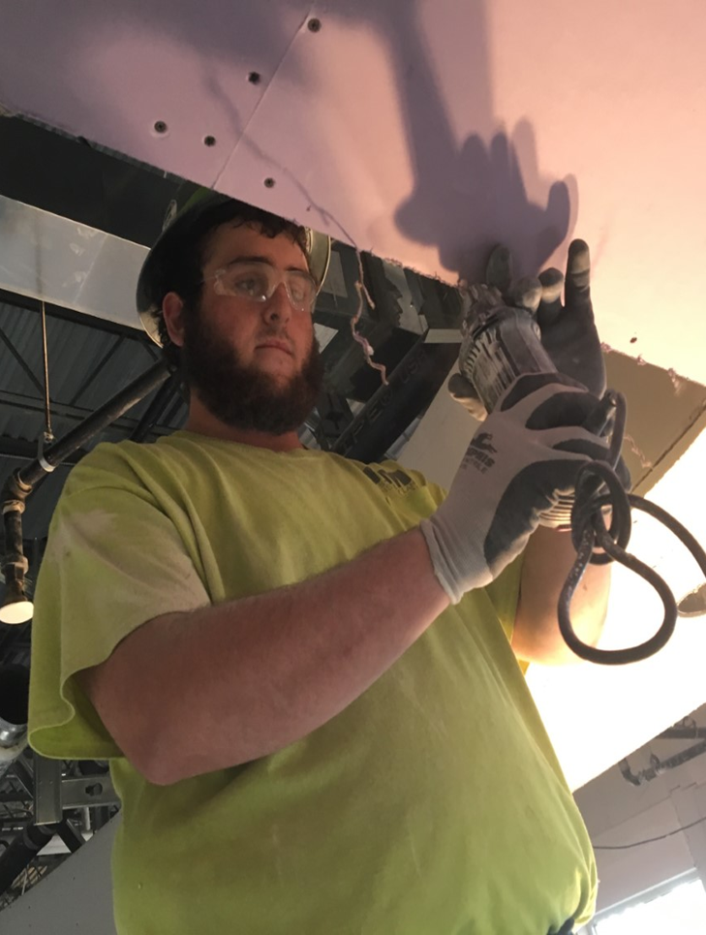

Slide 7
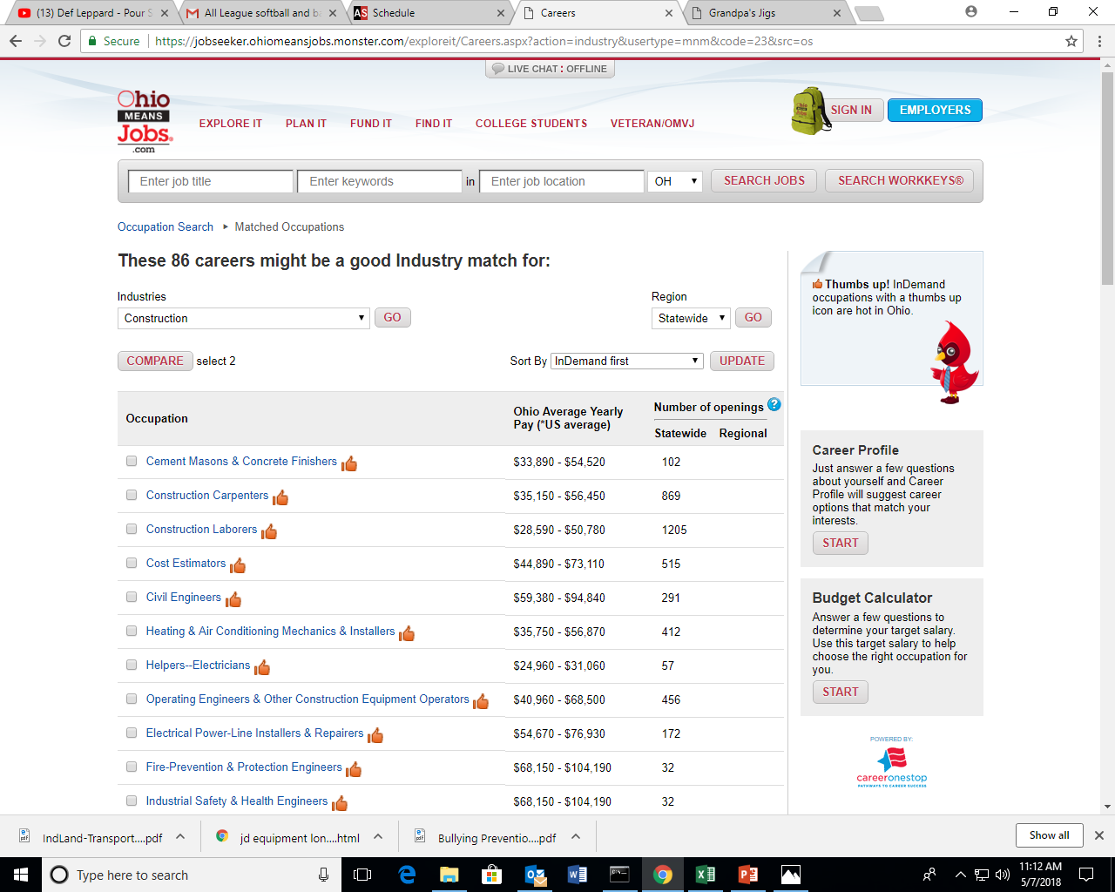
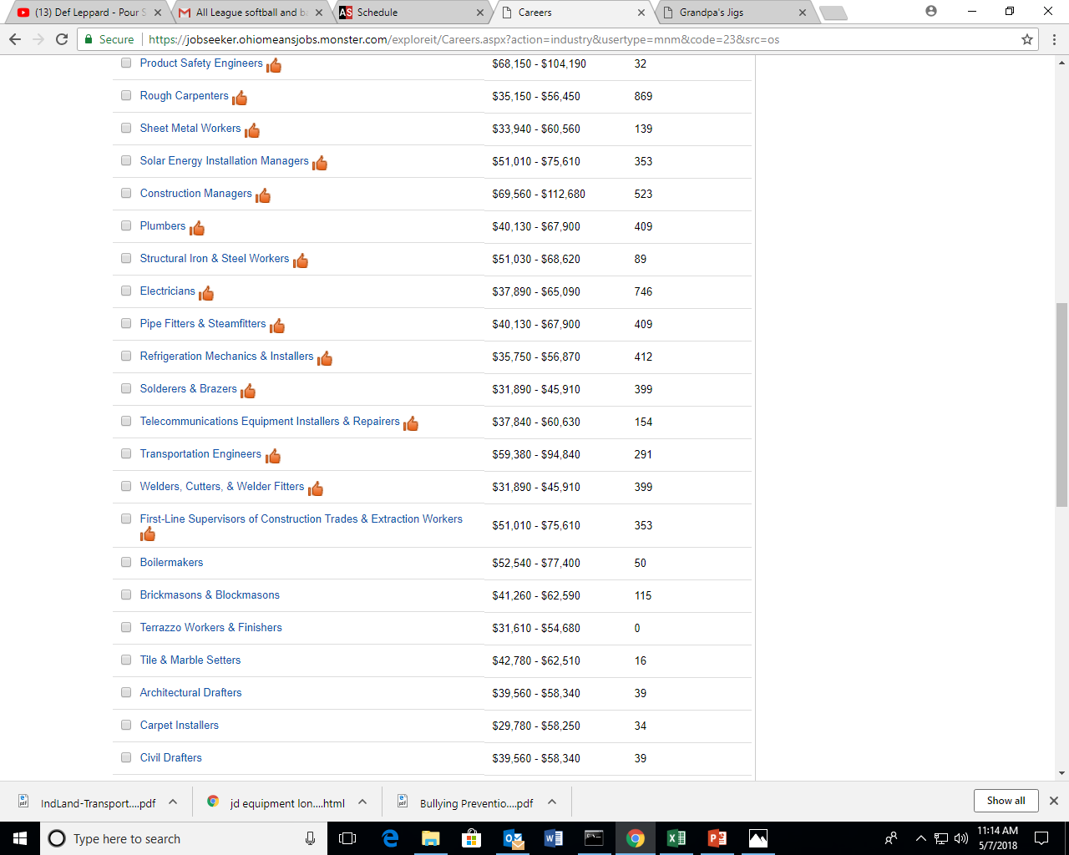

Slide 8
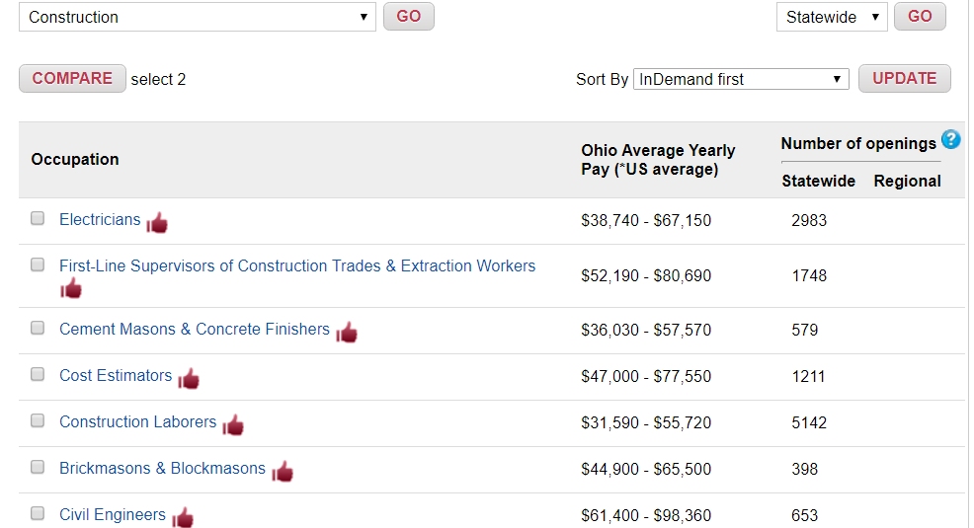

Slide 9
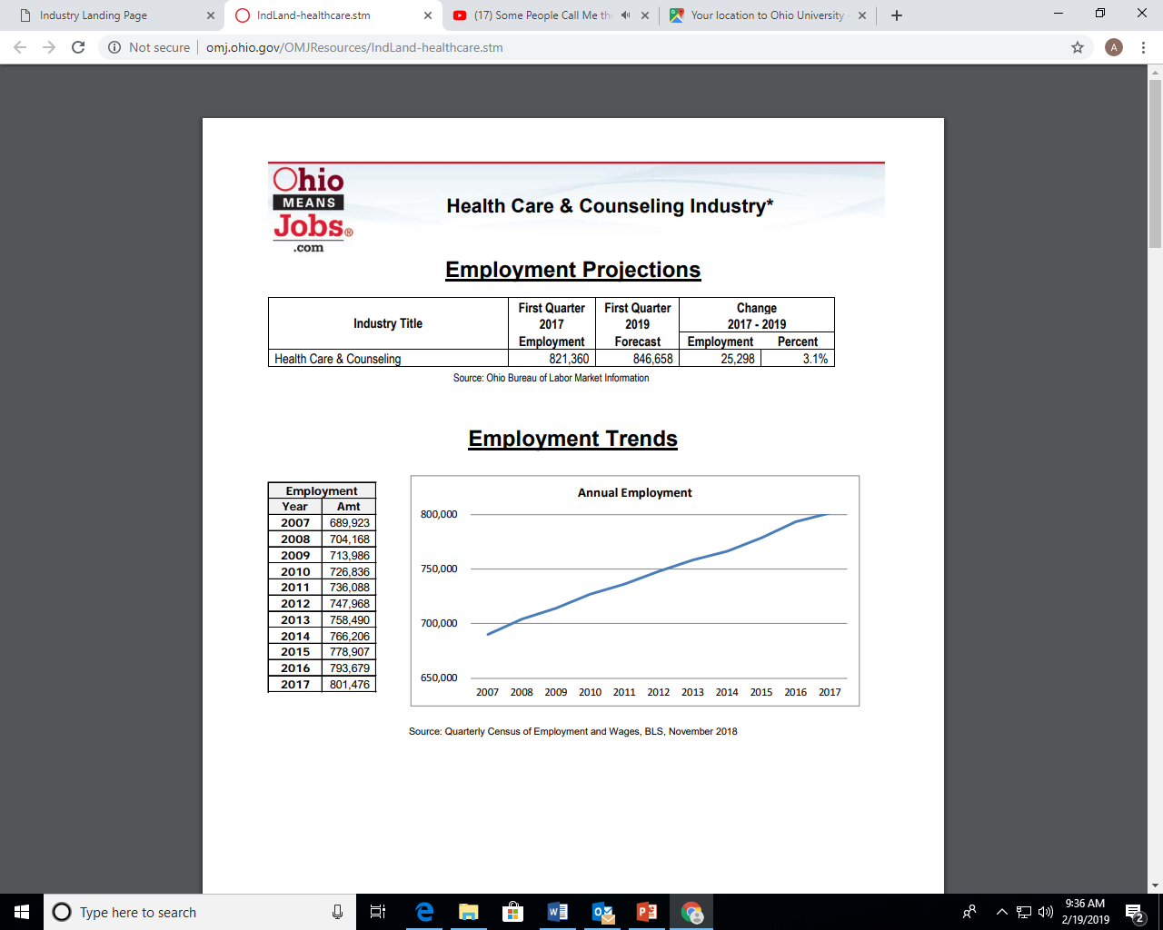

Slide 10
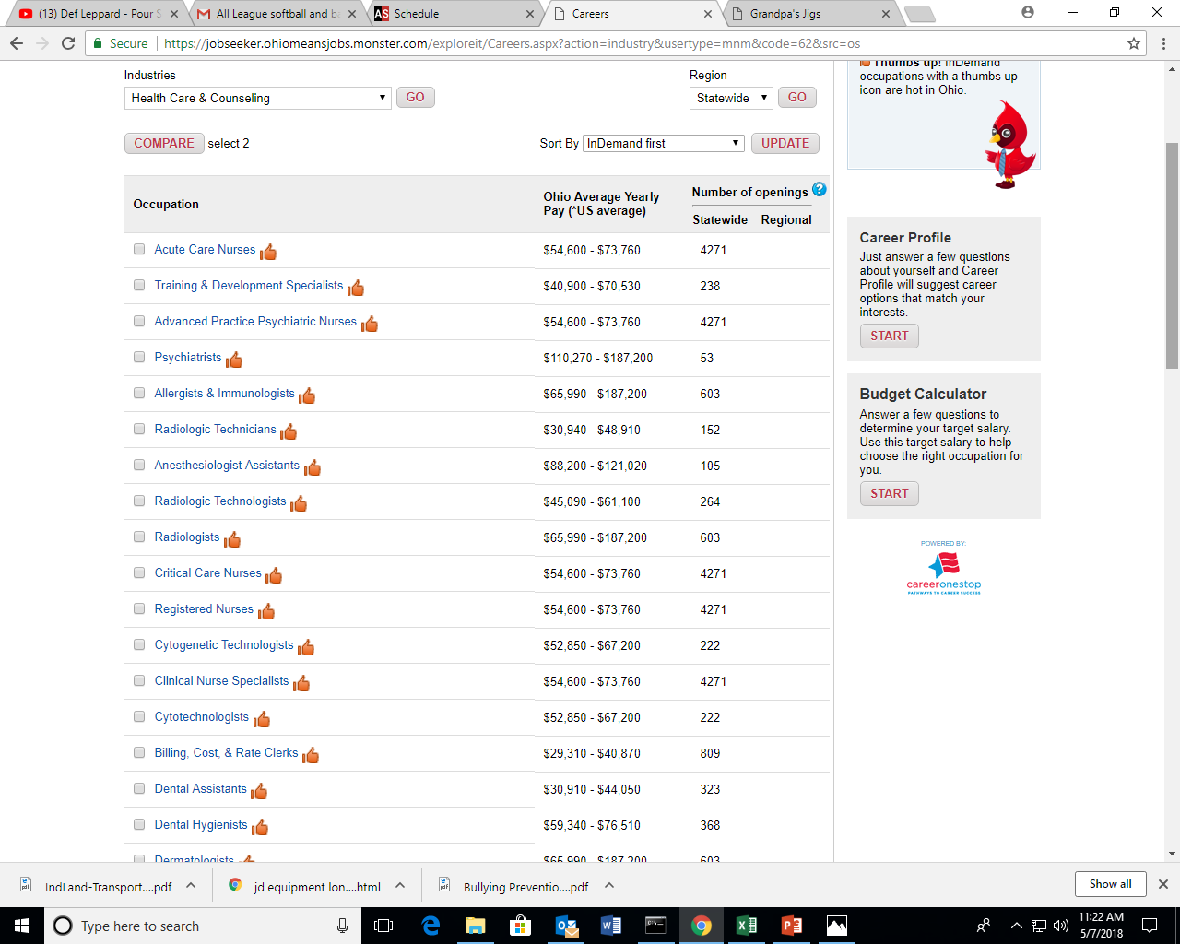
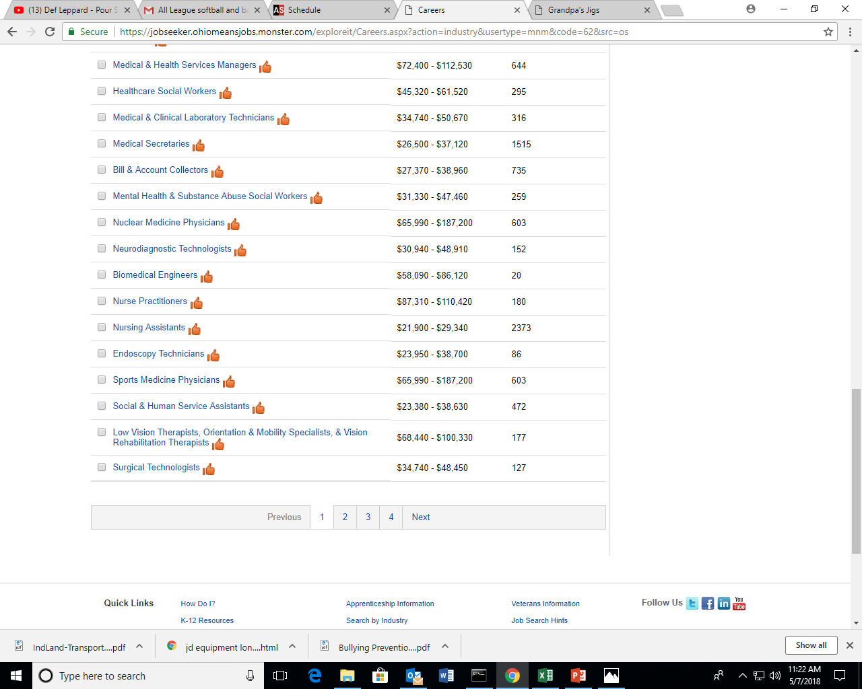
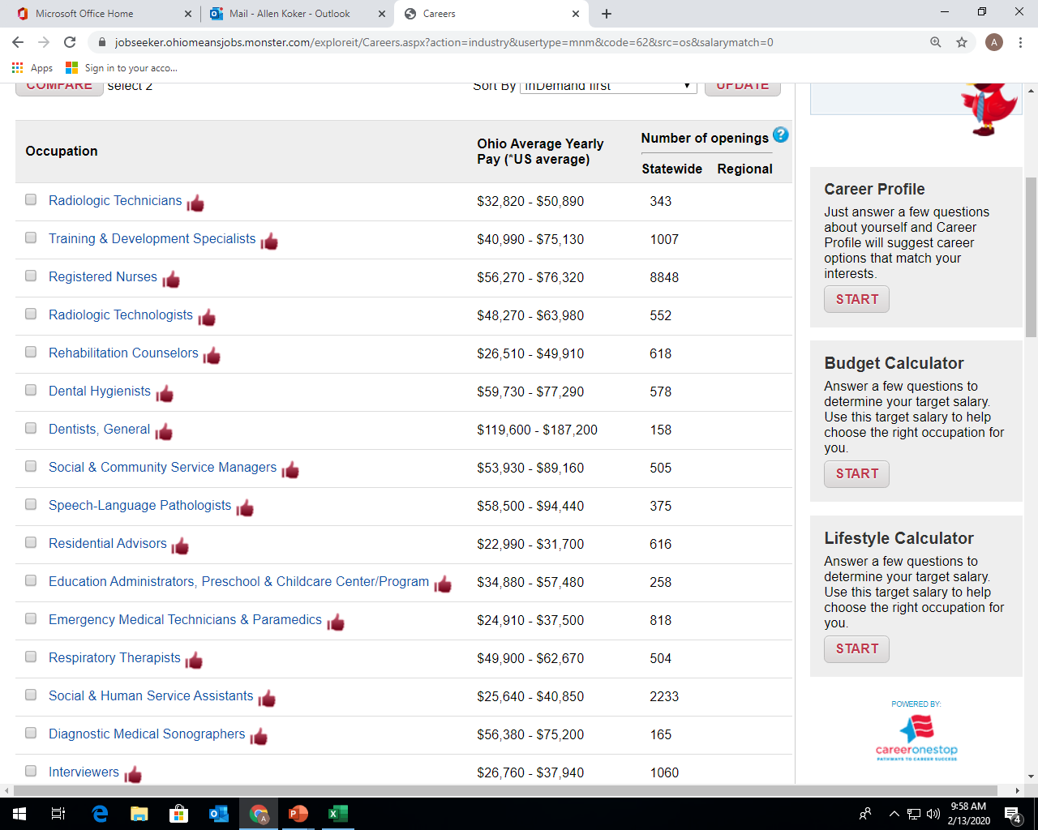
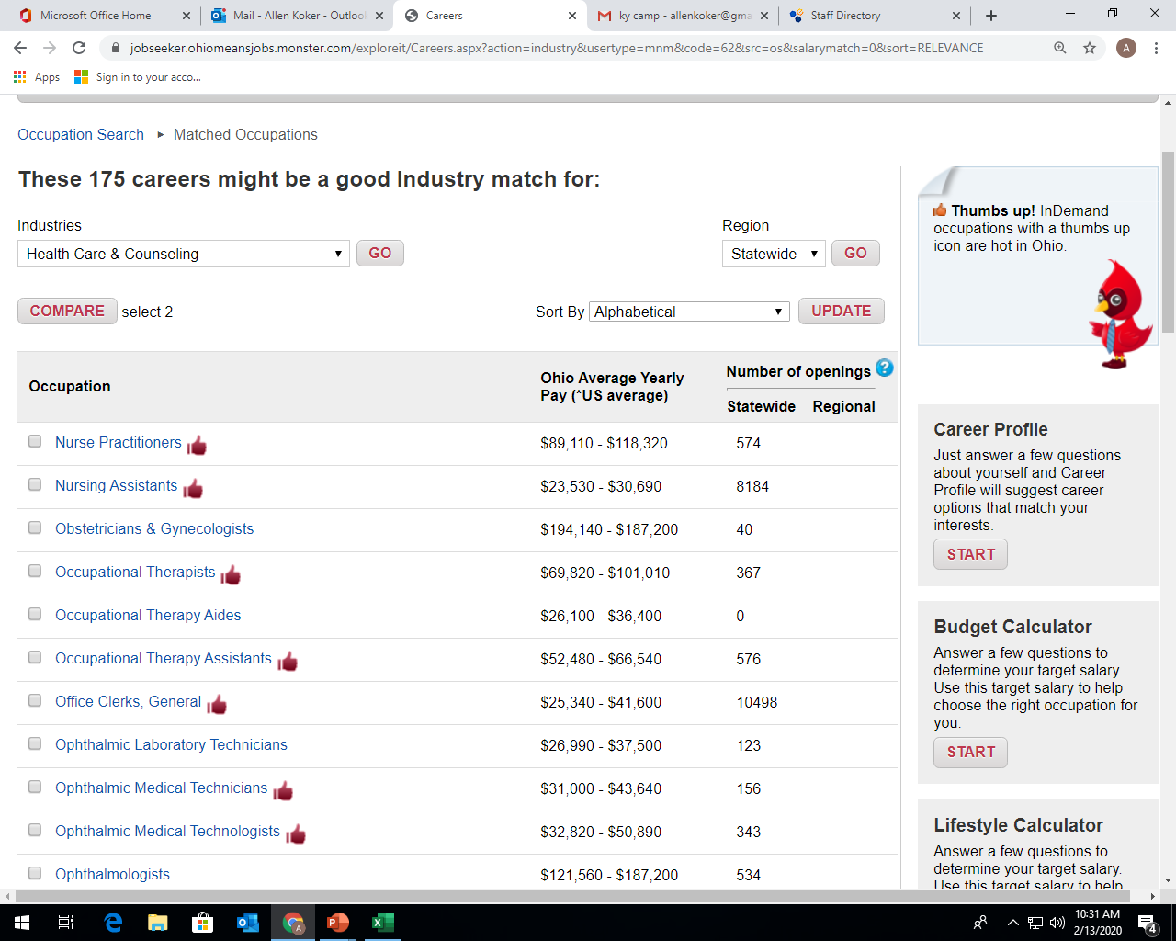
2018-2019
2019-2020

Slide 11
Job Placement
Denier Electric
IBEW
Sofidel
Company Wrench
Lithko
EG Industries
Accurate Industrial
Horton Emergency
TOSOH
MHC Kenworth
Rural King
Clearcreek Construction

Slide 12
Job Placement
Heartland Nursing
Westmoreland
Signature
Traditions
Wyngate
Adena Health System
Logan Elm Health
Valley View
Wal-Mart
Lowes

Slide 13
Keys to Good Relationships
Meeting Employers Needs in a Timely Manner
Regular Job Site Visits
Background of Students
Providing Quality/Skilled Workers
Showing Appreciation (Plaques/Certificates)

Slide 14
Registered
Apprenticeship

Slide 15
Our Path to Registered Apprenticeship
In early January 2019, met with Matthew Longfellow and PRCTC adult education stakeholders to identify our target occupations
  Electrical, HVAC, and Maintenance
Worked closely with ApprenticeOhio to develop program standards and related instruction components
On August 20, 2019, Accurate Mechanical of Chillicothe became a signatory employer for our HVAC apprenticeship
On September 1, 2019, MK Electric LLC of Lancaster signed on for our Electrical apprenticeship

Slide 16
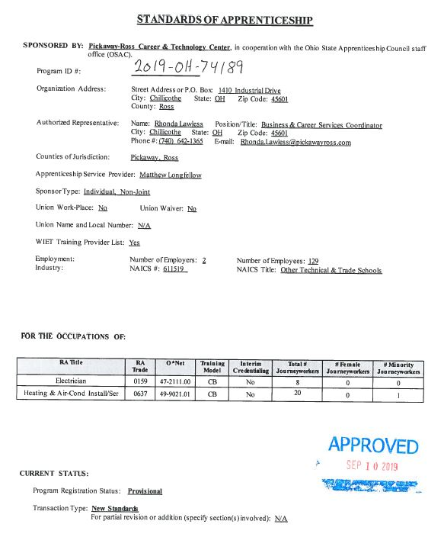

Slide 17
Approved Apprenticeship Occupations
Electrical
HVAC
NCCER Curriculum
Each begins with 600-hr full-time, financial aid eligible program in Year 1
Related instruction of varying hours (minimum 144 per year) for Years 2 and 3

Slide 18
Electrical
600 hours consists of:
  NCCER Core, OSHA 10 General Industry, NCCER Electrical Levels 1 & 2, CPR/First Aid, STEP (Year 1)
Related Instruction hours consists of:
  NCCER Electrical Level 3 & 4
  Total additional related instruction of 335 hours (Years 2 & 3)

Slide 19
HVAC
600 hours consists of:
  NCCER Core, OSHA 10 General Industry, NCCER HVAC Levels 1 & 2, EPA 608 & R410A training and certification, CPR/First Aid, STEP (Year 1)
Related Instruction hours consists of:
  NCCER HVAC Level 3 & 4
  Total additional related instruction of 325 hours (Years 2 & 3)

Slide 20
WHAT'S NEXT?
Add signatory employers for both approved occupations and maintenance
Obtain approval for additional occupations to provide pathway for pre-apprenticeship
  Auto Mechanics
  Welding
  Health
  Public Safety
  IT

Slide 21
Questions
Jason Vesey – Director of Secondary Education
jason.vesey@pickawayross.com
Kim Graves – Job Placement Coordinator - kim.graves@pickawayross.com
Allen Koker – Job Placement Coordinator – allen.koker@pickawayross.com
Rhonda Lawless - Business Services Coordinator – rhonda.lawless@pickawayross.com
Susan Schwalbauch – ACAD Specialist – susan.schwalbauch@pickawayross.com

